Slide 1



Data Analytics
Unit 3 - SQL joins, Sub Queries, ML- Classification, Regression
NOV 2020 | BERLIN

Slide 2

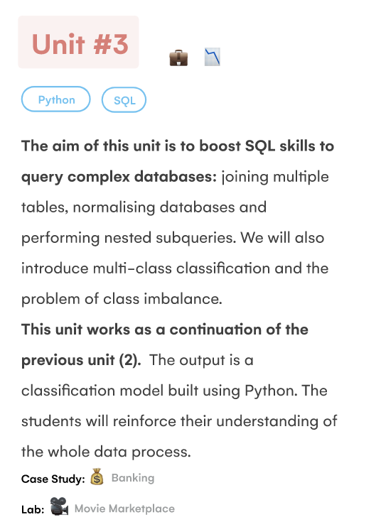
What will I learn in this unit?

Slide 3
What will I learn in this unit?
Objectives / concerns
Switching to online --- concerned how this is going to go
practicalities , working from home
Query about the data clean project ?
Working with python and ML - nervous about gaps in knowledge from first week - jupyter notebooks shared
HAVING
WINDOW FUNCTIONS

Slide 4
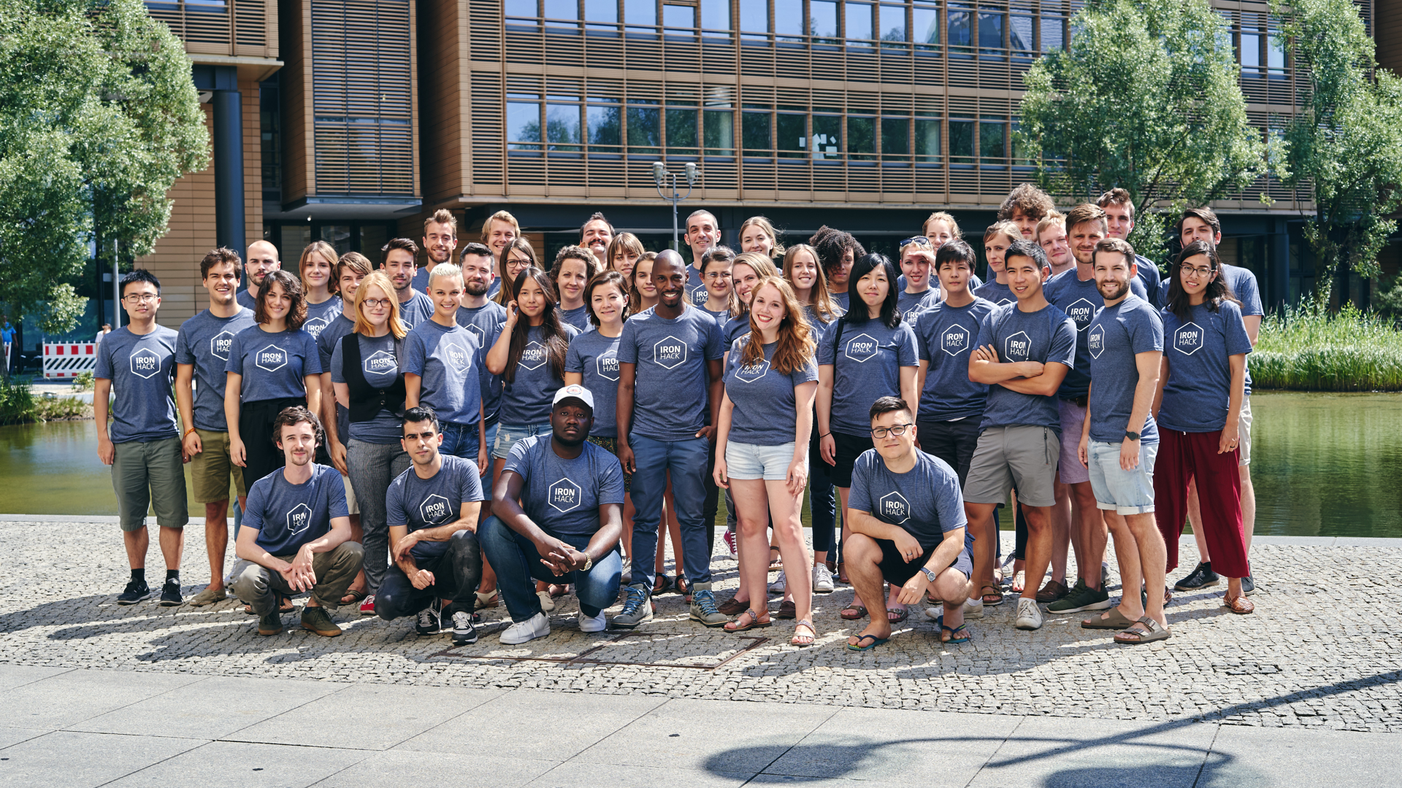

Fun day - Monday

Slide 5

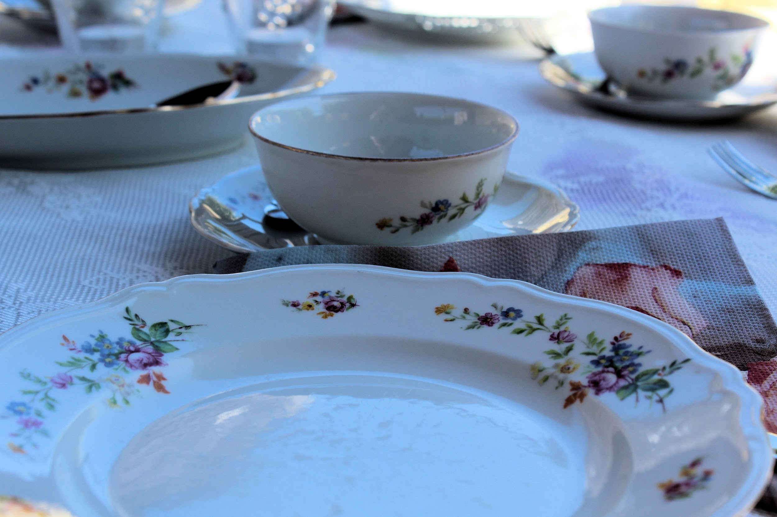

Morning session
Afternoon Session
Lab Session
The Best of - class challenge from this morning
Keys, Cardinality
BOG - Planning a Join query
Joins - multiple tables (2+)
SQL Logical processing order review
-Chair yoga break
-fresh air break 20 mins
Guide for Zoom learning
Class NoticeBoard
Review Section
Review challenge - Sian’s example,
Students try
-mid morning break 20 mins
Using Bank data:
SQL Joins, LEFT, RIGHT
-lunch 12:30- 1:30
->TA assisted Lab Groups 16:00-
Catch up on UNIT 2 Labs 1-9
Review and update missing submissions on student portal
SQL Logical processing order
Unit 3 Labs:
Lab SQL Join
Stretch - Lab SQL Join multiple tables ; continue working on this morning’s review challenge with Python + SQL
Notes:
Tomorrow
More on joins multiple tables
Stretch lecture:
- self joins and cross joins
QL comfort zone - class quiz /kahoot
Stretch : Lab SQL Self and Cross join
Using temporary tables
BOG - SQL views /stored procedures

Slide 6

Lets start with...
REVIEW
Connect to MariaDB online
Select a database
Launch jupyter notebook
Connect to the DB via Python
Create a dataframe from the DB using SQL queries and pandas
Visualise the df in Python using Seaborn or MatplotLib
Choose visualisation(s) which answer your data question(s)

Slide 7
Example : What are we trying to find out?
World database contains information about 239 countries
We want to see the density of the population per sq km
What are the top 25 most dense countries?
Excluding any zero/unknown values
What are the capitals of those countries?
Which capitals have the biggest proportion of the country population ?
Can we reasonably infer capital city population based on country population density?

Slide 8
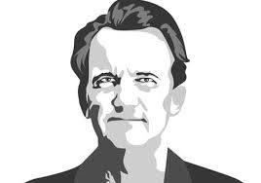
“Above all else, show the data.” – Edward R. Tufte

Slide 9

Two Day - Tuesday

Slide 10
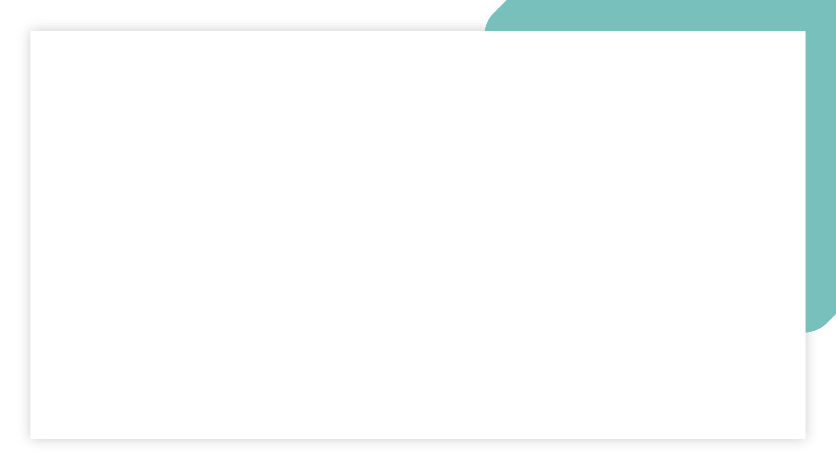
Morning session
Afternoon Session
Lab Session
Guest lecture 1pm
BOG - SQL views /stored procedures
Temporary tables - CA 3.2.3
Examples of self joins
Stretch - Self Joins - w3 schools
Stretch - Cartesian product & cross joins- example with menu
5 min getupanddance break
Self contained sub queries- CA 3.4.4
Sub queries +where -CA 3.5.1,2,3
-fresh air break 20 mins
9:00 kata
break
10am Review of labs
Icebreaker
Break
Window functions - CA 3.2.2
-lunch 12:00 - 13:00
->TA assisted Lab Groups 16:30-
Unit 3 Labs:
stretch - Lab SQL self cross Join
Skip lab on normalisation!
Lab SQL subqueries
Notes:
Introducing this week’s project
Start work on this weeks project

Slide 11
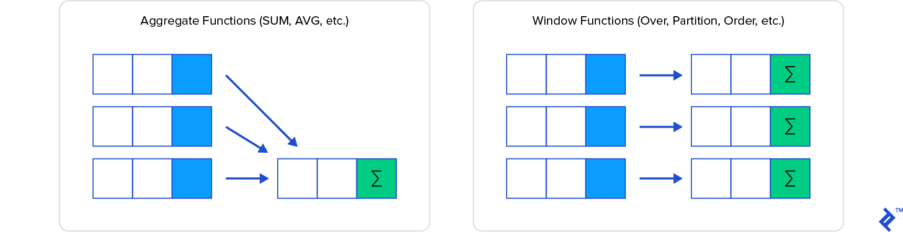
Window functions

Slide 12
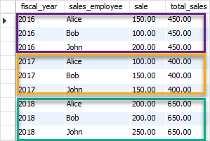
Window functions
Select SUM(sale)
OVER (
Partition BY fiscal_year)
As ‘total_sales’
From salestable
Aggregation eg SUM()
OVER
Partition by fiscal_year
SUM(profit) OVER(PARTITION BY country)

Slide 13
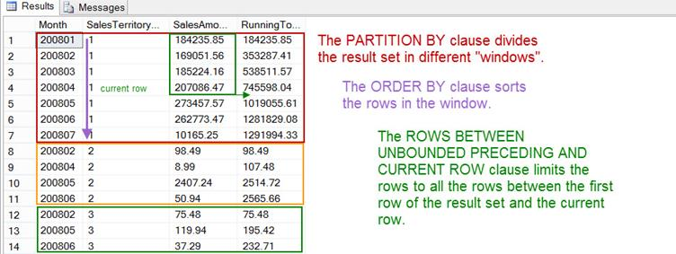
Window functions

Slide 14
Window functions
Window = “Partition” (PARTITION BY) + “Ordering” (ORDER BY) + “Frame” (ROW/RANGE)
OVER defines the set where the function will be applied
OVER (
PARTITION BY -> Divides the set in “chunks” where the function is applied independently (similar to GROUP BY)
ORDER BY -> How to sort the elements within the partition
ROW or RANGE -> Set “boundaries” within each “chunk”
) [AS alias]

Slide 15
IRONHACK BOOTCAMP
WINDOW = PARTITION + ORDER + FRAME
New col
Order
Frame
Partition
Order
Frame
Partition

Slide 16
IRONHACK BOOTCAMP
IRONHACK BOOTCAMP
Next steps : ADDING ORDER TO THE WINDOW
SELECT fruit, size, avg(size) OVER (PARTITION BY fruit ORDER BY fruit DESC) AS Mean_size FROM table
fruit | size
Apple | 34
Apple | 23
Coconut | 15
fruit | size | Mean_size
Coconut | 15 | 15
Apple | 34 | 28.5
Apple | 23 | 28.5

Slide 17
IRONHACK BOOTCAMP
IRONHACK BOOTCAMP
Bank database window functions
select loan_id, account_id, amount, payments, duration, amount-payments as "Balance",
avg(amount-payments) over (partition by duration) as Avg_Balance
from bank.loan
where amount > 100000
order by duration, balance desc;
select loan_id, account_id, amount, payments, duration, amount-payments as "Balance",
avg(amount-payments) over (partition by duration order by duration asc, amounts desc) as Avg_Balance
from bank.loan
where amount > 100000;

Slide 18

‘Hump day’ Wednesday

Slide 19

Morning session
Afternoon Session
Lab Session
Nerdiest tshirt - time to vote!
Common Table Expressions CA 3.06.1
Working with Views CA 3.06.2,3
5 min getupanddance break
Correlated subqueries - intro CA 3.6.4
Fresh air break
Introducing this week’s project
Yoga- chair yoga or …
9:00 morning sunshine
Review /of Labs
Examples of self joins
break
join v subquery
CA 3.05.2
Nested subqueries parent/child
break
Revisit Rank (window fx)
Walk through CA 3.05.3
-lunch 12:30 - 14:00
->TA assisted Lab Groups 16:30-
Unit 3 Labs:
Lab SQL Advanced Queries
(optional) Review / have another go at in class activities from today
Start work on this weeks project

Slide 20
Morning session
Afternoon Session
Lab Session
Nerdiest tshirt - time to vote!
Finish on subqueries
Common Table Expressions CA 3.06.1
Working with Views
5 min getupanddance break
Fresh air break
Introducing this week’s project
yoga
9:00 morning sunshine
Review /of Labs
Examples of self joins
join v subquery
CA 3.05.2
break
Nested subqueries parent/child
Revisit Rank (window fx)
Walk through CA 3.05.3
-lunch 12:30 - 13:30
->TA assisted Lab Groups 16:30-
Unit 3 Labs:
Lab SQL Advanced Queries
(optional) Review / have another go at in class activities from today
Start work on this weeks project
Notes:
Introducing this week’s project
Start work on this weeks project
Stretch - Self Joins - w3 schools
Stretch - Cartesian product & cross joins- example with menu
Correlated subqueries - intro CA 3.6.4
CA 3.06.2,3

Slide 21

Nearly there Thursday

Slide 22

Morning session
Afternoon Session
Lab Session
9:00 SQL quiz with Flo
Review /of Labs
-break-
Time on group project - (1hr -timngs TBC)
Review the Bank case study- outline of afternoon goals
Demo - analysing customer behaviour in Bank data with SQL queries
-lunch 12:30 - 14:00
Demo - analysing customer behaviour in Bank data with SQL queries ( CA 3.07.1,2,3)
-yoga break-
Review of machine learning end to end workflow
EDA and pre processing
How to use classification models to predict customer status (cont friday)
Binary v multi class classification
Using logistic regression
->TA assisted Lab Groups 16:15-
Unit 3 Labs:
Lab 7 - SQL rolling calculations
Lab 8 - Making predictions with logistic regression (to be continued in tomorrow’s Lab session)
Continue work on this week’s group project
Notes:
Continue tomorrow

Slide 23
Bank Customer Analysis: What are we trying to find out?
Bank contains data about customer loans, repayments and status, as well as some customer demographics
Overall TASKs are:
Identify the good clients to whom we can offer other services
Identify the bad clients that have to watch carefully to minimize the losses
Can I use SQL to analyse customer behaviour and start identifying good/ bad customers? What about identifying any problems that the Bank has in general ?
Notes:
Whats your sql comfort zone - kahoot quiz
Project time

Slide 24
Bank Customer Analysis: What are we trying to find out?
Problem # 1 = Customer Churn / attrition
Let’s find out month to month, how many customers were doing transactions.
Tool = LAG function
Approach - create a View, use CTE where useful
https://www.sqlservertutorial.net/sql-server-window-functions/sql-server-lag-function/
Notes:
Whats your sql comfort zone - kahoot quiz
Project time

Slide 25
Bank Customer Analysis: What are we trying to find out?
Problem # 1 = Customer Churn / attrition
Let’s find out how many customers keep doing transactions
the next month, that they did in previous months
Tool = self join
Approach - create a View
https://www.sisense.com/blog/use-self-joins-to-calculate-your-retention-churn-and-reactivation-metrics/
Notes:
Whats your sql comfort zone - kahoot quiz
Project time

Slide 26
Bank Customer Analysis: What are we trying to find out?
Problem # 1 = Customer Churn / attrition
Let’s figure out the difference of ‘active’ users month to month, ie how many more ‘active’ customers this month than last month
Tool = window function for a rolling difference
Approach - subquery
https://www.sisense.com/blog/use-self-joins-to-calculate-your-retention-churn-and-reactivation-metrics/
Notes:
Whats your sql comfort zone - kahoot quiz
Project time

Slide 27

TFI Friday

Slide 28

Morning session
Afternoon Session
Lab Session
9:00 Morning sunshine
Lab code along with Andres
-break-
Assumptions of Logistic Regression Models
Predicting customer status
Extract + Clean
Preprocessing
-lunch 12:35 - 13:35
Train Test Split
Apply the Model
Check results and Evaluate
Using logistic regression for multi class problems - students do activities:
Extract the data CA 3.08.1
EDA
Data wrangling CA 3.08.2
Check the accuracy CA 3.09.1
UNIT 3/week 3 Retro with TAs
->TA assisted Lab Groups 15:30-
Unit 3 Labs:
Lab 8 - Making predictions with logistic regression
(optional) CA 3.08.3 pre processing
(optional) CA 3.09.3 multicollinearity
(optional) Continue work on this week’s group project
Notes:
Pre-processing CA 3.08.3
Fit the model
Make predictions
BOG / Class discussion CA 3.09.2,3
Imbalance/upsampling/ downsampling CA 3.09.4
Lab 9 - stretch - Imbalanced Data

Slide 29
Bank Customer Analysis: What are we trying to find out?
Bank contains data about customer loans, repayments and status, as well as some customer demographics
Overall TASKs are:
Identify the good clients to whom we can offer other services
Identify the bad clients that have to watch carefully to minimize the losses
Can I use the Bank DB + ML to analyse customer behaviour and start identifying good/ bad customers? What about identifying any problems that the Bank has in general ?

Slide 30
Bank Customer Analysis: What are we trying to find out?
Problem # 2 = bad/good customers - loan status
Let’s find out month to month, how many customers were doing transactions.
Can we predict the status of a loan based on the fields we have from the loan table and the transactions?
Approach - develop a classification model to predict the status of the loan.
Tool = logistic regression

Slide 31
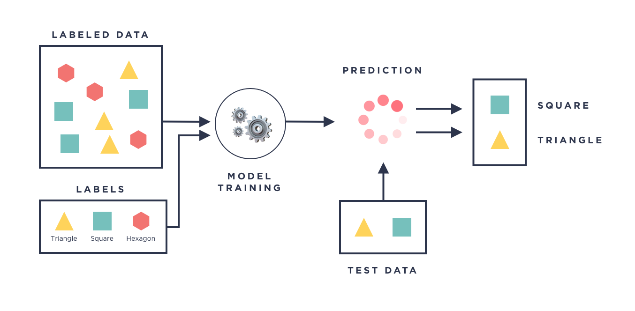
IRONHACK BOOTCAMP
SUPERVISED MACHINE LEARNING MODELS
Supervised machine learning models are all the model which needs to be trained based on examples:

Slide 32
What is logistic regression?
Logistic regression is a technique for modelling the probability of an event.
Just like linear regression, it helps you understand the relationship between one or more variables and a target variable
Except that our target variable is binary: its value is either 0 or 1.
Example:
It’s possible to say that “smoking can increase your risk of having lung cancer by 20%”, since having lung cancer is a binary variable: you either have it or not.
From that, we can infer classification probability based on other factors
like whether someone will have lung cancer given that he/she does not smoke, lives in a polluted city and has a family history of lung cancer.

Slide 33
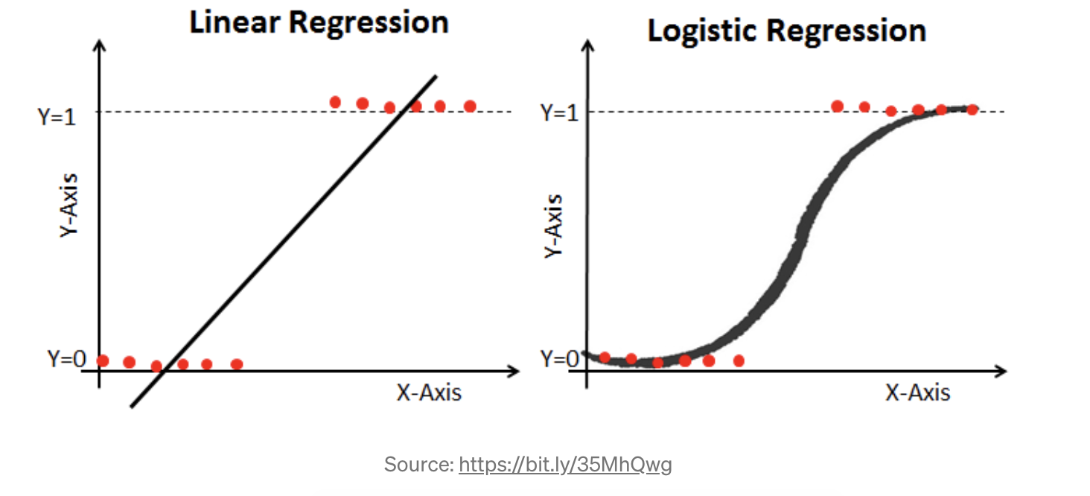
Understanding logistic regression
To better understand the difference between a linear and a logistic regression, imagine we plotted the lung cancer variable in the Y-axis (Y = 1 if patient has lung cancer and 0 otherwise) and the patient’s age in the X-axis.
Here we have the resulting lines from each regression. Which one seems more fit to our data?

Slide 34
When to use logistic regression?
When linear regression makes no sense for our data - eg if we follow a line the linear approach would take us > 100%
Logistic ensures a curve cannot exceed 100% or go below 0
Where response variable is a proportion
When we want a model to predict probabilities of different possible outcomes of a categorically distributed response variable, given a set of independent variables
*NB dont confuse with logarithmic scale

Slide 35




IRONHACK BOOTCAMP
NO FREE-LUNCH THEOREM
Every model makes assumptions about data. If those assumptions are not met, the model is doomed to fail.
Model assumptions determine the pre-processing.
Preprocessing
Preprocessing
Model
Model

Slide 36
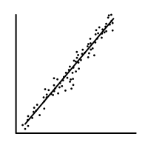
IRONHACK BOOTCAMP
LINEAR MODEL (for regression)
The linear model makes the following assumptions:
Require a linear relationship between the dependent and independent variables.
The error terms (residuals) need to be normally distributed.
If not weights can be introduced to penalize some observations in the error metric.
Independent and dependent variables are normally distributed.
If not (apply transformation Box-Cox)
Absence of multicollinearity.
Independent observations (not repeated).

Slide 37
IRONHACK BOOTCAMP
LOGISTIC MODEL (for classification)
The logistic model makes the following assumptions:
NOT require a linear relationship between the dependent and independent variables.
The error terms (residuals) NOT need to be normally distributed.
Independent observations (not repeated).
Multicollinearity NOT RELEVANT.
Dependent variable MUST categorical and can only have two possible values. (yes/no, 1/o, True/False).
Larger dataset, at least 10 cases for each possible target value.

Slide 38
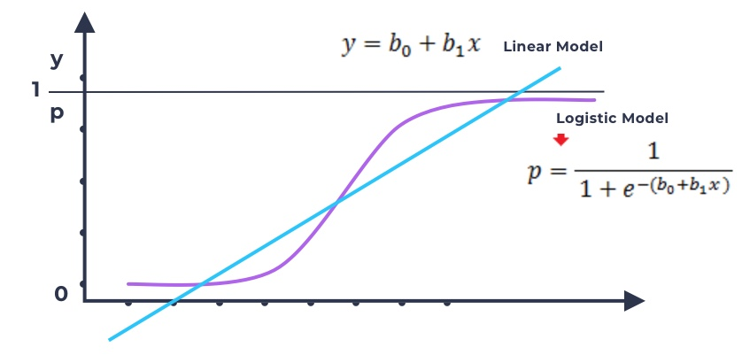

Slide 39
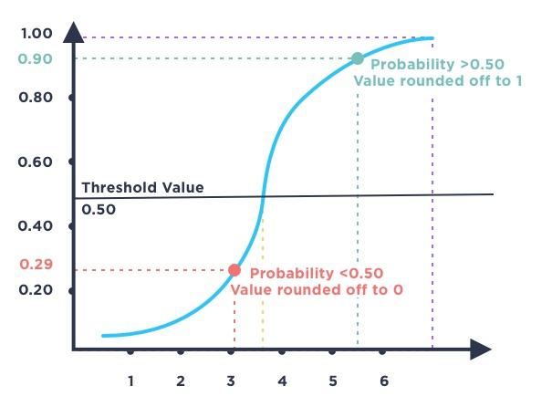
IRONHACK BOOTCAMP
DETERMINING THE PREDICTION OF THE LOGISTIC MODEL

Slide 40
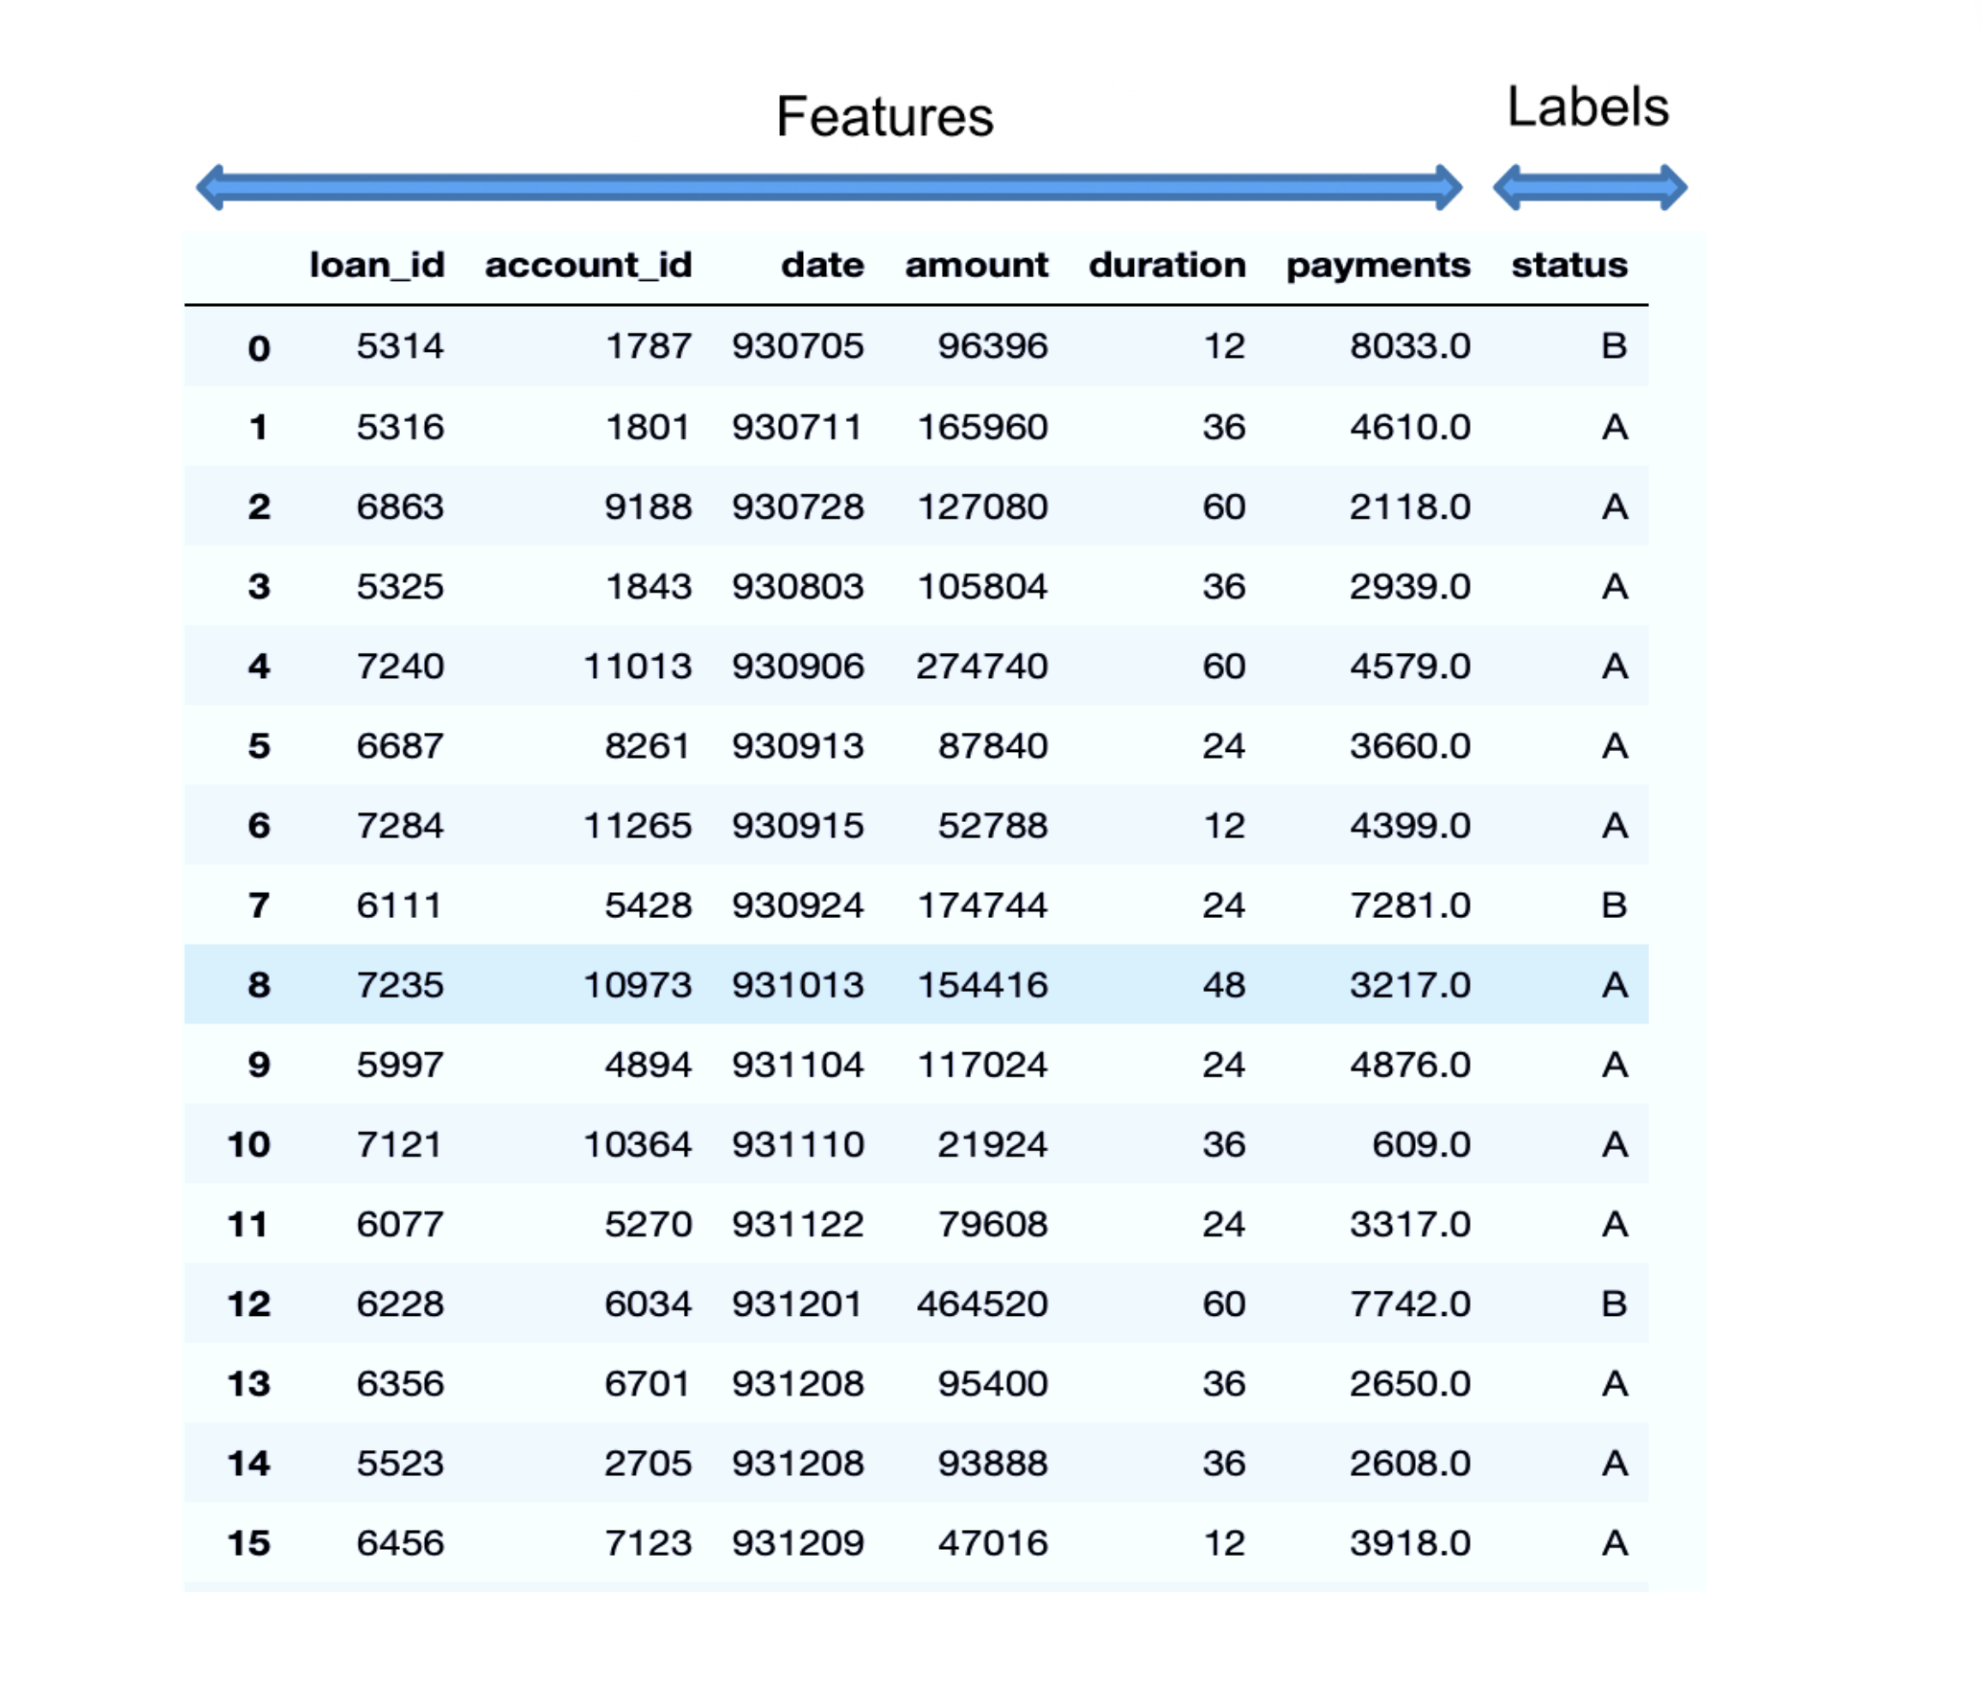
IRONHACK BOOTCAMP
IRONHACK BOOTCAMP
IRONHACK BOOTCAMP
Terminology
Classification Problem:
Predicting target variable that are labels
... in this case a binary (A or B, True or False, Yes or No, 1 or 0)

Slide 41
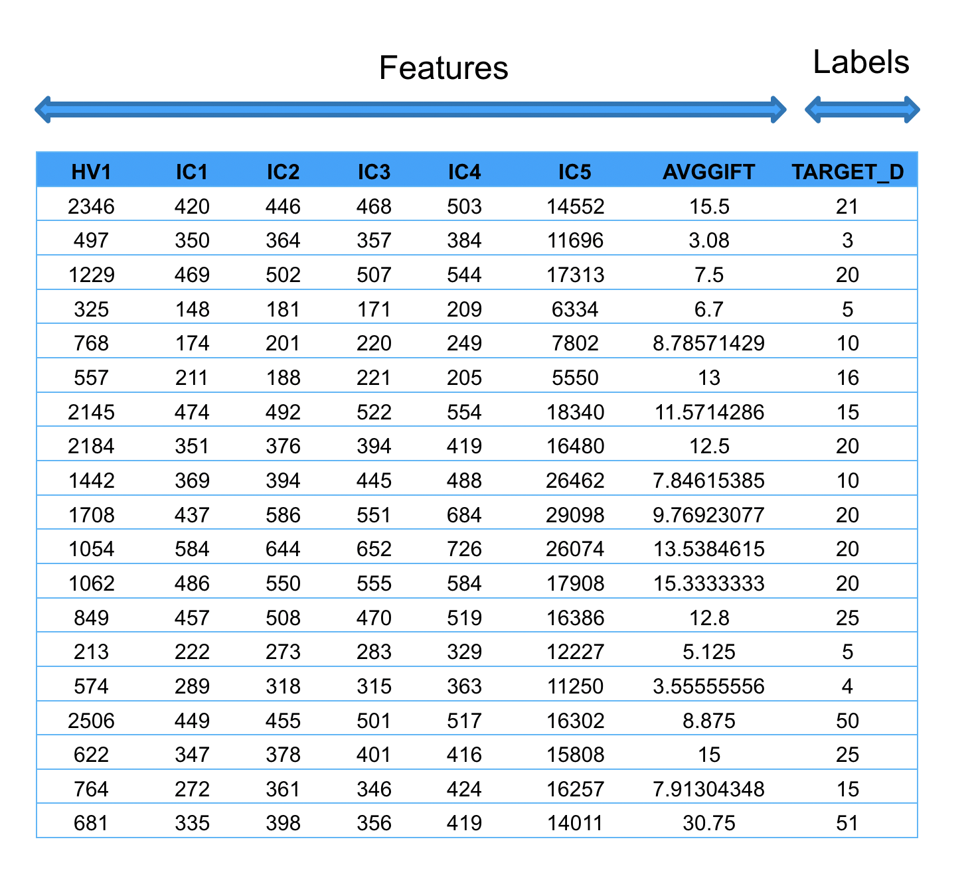
IRONHACK BOOTCAMP
IRONHACK BOOTCAMP
Terminology
Regression Problem:
Predicting an amount
Target_D is the dependent variable.
The features are the independent variables.

Slide 42
IRONHACK BOOTCAMP
stage 1 - IMPORTING DATA
query = '''select * from trans t
left join loan l
on t.account_id = l.account_id
where l.status in ('A', 'B');'''
data = pd.read_sql_query(query, engine)
data.head()

Slide 43
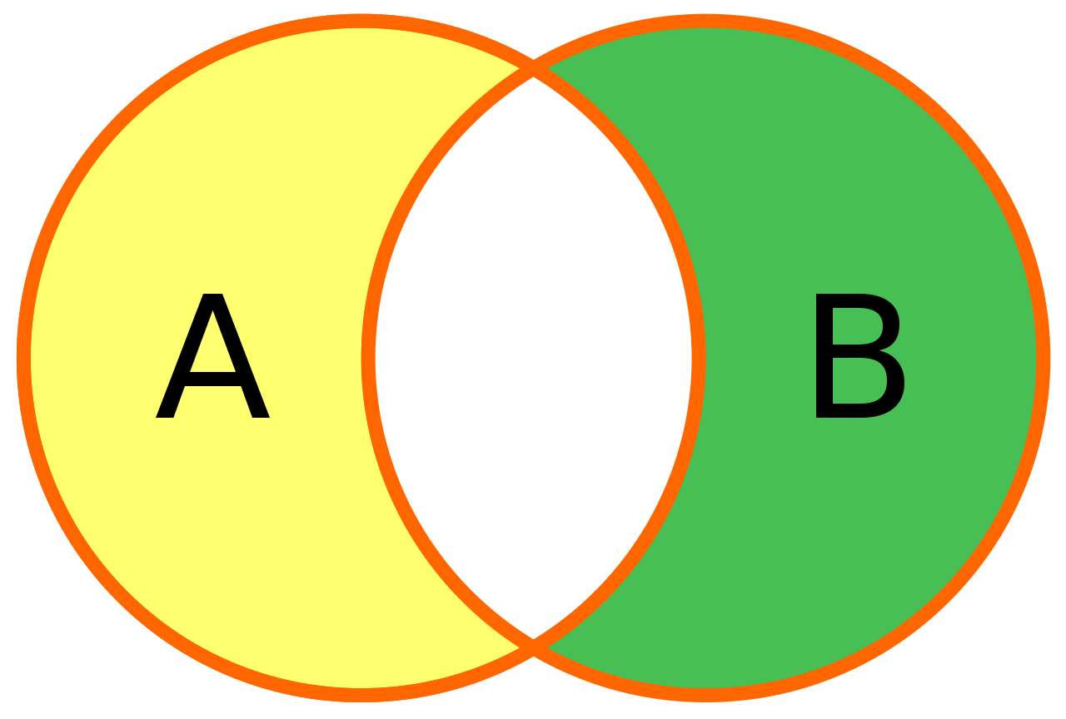
IRONHACK BOOTCAMP
WHAT DO WE WANT TO PREDICT?
We want to predict the “STATUS” of a bank customer.

Slide 44
IRONHACK BOOTCAMP
IMPORTING SQL DATA INTO PYTHON
We can do a left join
query = '''select t.type, t.operation, t.amount as t_amount, t.balance, t.k_symbol, l.amount as l_amount, l.duration, l.payments, l.status from trans t
left join loan l
on t.account_id = l.account_id
where l.status in ('A', 'B');'''
data = pd.read_sql_query(query, engine)
data.head()

Slide 45
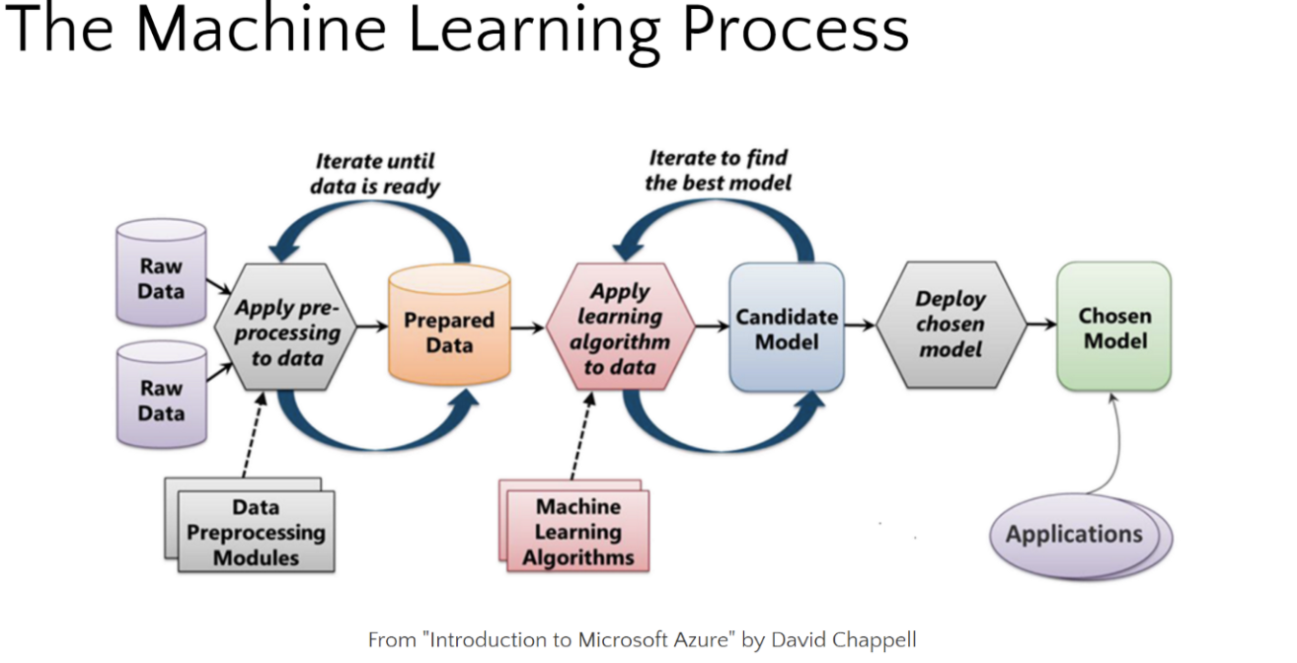

Slide 46
Next stages
Create a data frame in pandas/python
Use EDA methods to explore the data
Identify any clean/wrangle steps
Pre processing needed ?
T-T split and Run the model

Slide 47
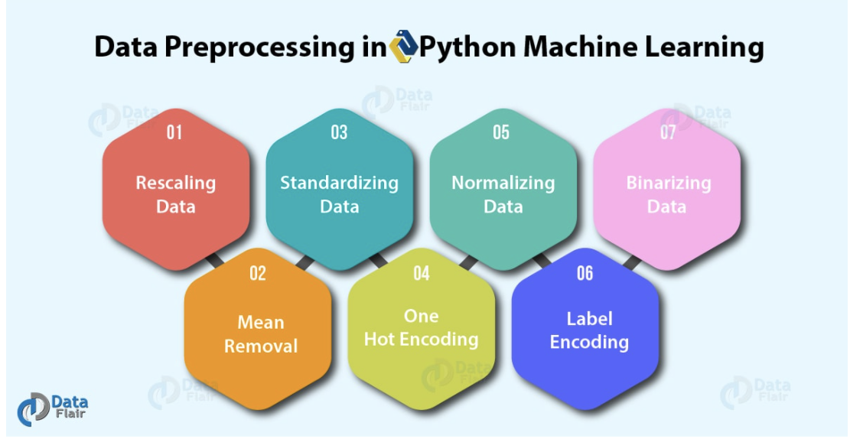
4. Pre-processing

Slide 48
4. Pre-processing
Q: are the data types correct? Treat any num as categ.?
T: Check for multi collinearity
Q: Are the features skewed? If yes, normalise
NOTE - for logistic regression, skewness in independent variable is not a problem as is with linear regression. But transformation may help the model fit

Slide 49
5. Train Test split and Run the model
Test size 40%
Import logistic regression
Classification score

Slide 50
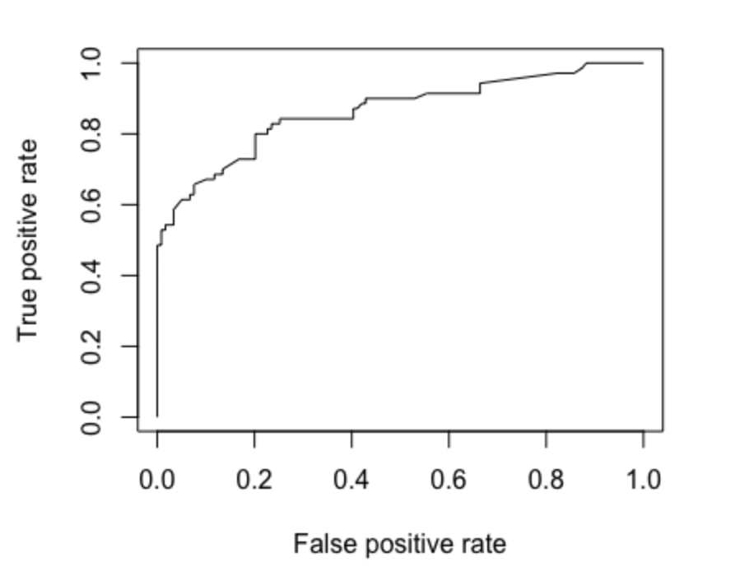
IRONHACK BOOTCAMP
Stage 6 - how can we evaluate a model?
Quick example - the Titanic data set
Accuracy = 0.82 (82%) is this good ? what if 99% died, and we had just guessed 100% death rate. We need to know the ROC
ROC (receiver operating characteristic)- plots true positives against false positives
Plot the curve - bigger the AUC (area under the curve) the better the model
We want a curve as close to top left as possible- AUC is 0.86 - quite good
Notes:
https://towardsdatascience.com/logistic-regression-the-basics-b1716661c71b

Slide 51
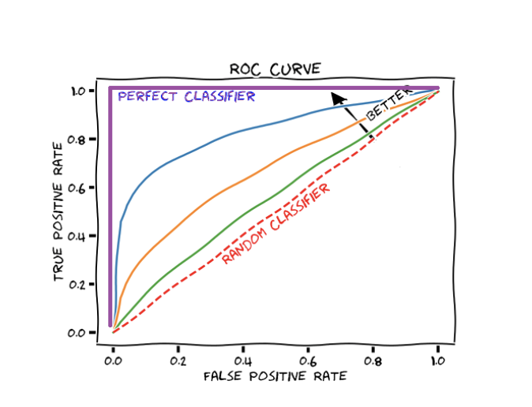
IRONHACK BOOTCAMP
IRONHACK BOOTCAMP
Stage 6 - how can we evaluate a model?
The ROC curve is a method to compare different settings for you model (threshold).
It answer the question of: “What is the best threshold to use?”
Each dot of the curve corresponds to a different value of the threshold
= Recall
= 1-(FP/(FN+TN)
Notes:
https://towardsdatascience.com/logistic-regression-the-basics-b1716661c71b

Slide 52
IRONHACK BOOTCAMP
IRONHACK BOOTCAMP
IRONHACK BOOTCAMP
Stage 6 - how can we evaluate a model?
GETTING THE ROC FROM SKLEARN
from sklearn import metrics
import matplotlib.pyplot as plt
y_pred_proba = classification.predict_proba(X_test)[::,1]
fpr, tpr, _ = metrics.roc_curve(y_test, y_pred_proba)
auc = metrics.roc_auc_score(y_test, y_pred_proba)
plt.plot(fpr,tpr)
Notes:
https://towardsdatascience.com/logistic-regression-the-basics-b1716661c71b

Slide 53
IRONHACK BOOTCAMP
IRONHACK BOOTCAMP
IRONHACK BOOTCAMP
Stage 6 - how can we evaluate a model?
GETTING THE CONFUSION MATRIX FROM SKLEARN
>>> from sklearn.metrics import confusion_matrix
>>> y_true = [2, 0, 2, 2, 0, 1]
>>> y_pred = [0, 0, 2, 2, 0, 2]
>>> confusion_matrix(y_true, y_pred)
array([[2, 0, 0],
[0, 0, 1],
[1, 0, 2]])
Notes:
https://towardsdatascience.com/logistic-regression-the-basics-b1716661c71b

Slide 54
IRONHACK BOOTCAMP
IRONHACK BOOTCAMP
IRONHACK BOOTCAMP
Stage 6 - how can we evaluate a model?
GETTING THE CONFUSION MATRIX FROM SKLEARN
>>> from sklearn.metrics import confusion_matrix
>>> y_true = ["cat", "ant", "cat", "cat", "ant", "bird"]
>>> y_pred = ["ant", "ant", "cat", "cat", "ant", "cat"]
>>> confusion_matrix(y_true, y_pred, labels=["ant", "bird", "cat"])
array([[2, 0, 0],
[0, 0, 1],
[1, 0, 2]])
Notes:
https://towardsdatascience.com/logistic-regression-the-basics-b1716661c71b

Slide 55
IRONHACK BOOTCAMP
CONFUSED? USE THE CONFUSION MATRIX!
Real
Positive
Negative
Positive
TP
FP
Predicted
Negative
FN
TN
Notes:
https://www.kaggle.com/utah12005/titanic-guided-by-a-confusion-matrix

Slide 56

IRONHACK BOOTCAMP
CONFUSED? USE THE CONFUSION MATRIX!
Real
Positive
Negative
If you are deemed to fail what kind of error do you prefer to make?
Positive
TP
FP
Type I error
Predicted
Negative
FN
TN
Type II error

Slide 57



IRONHACK BOOTCAMP
CONFUSED? USE THE CONFUSION MATRIX!
Real
Positive
Negative
Positive
TP
FP
Type I error
Predicted
Negative
FN
TN
Type II error

Slide 58

IRONHACK BOOTCAMP
CONFUSED? USE THE CONFUSION MATRIX!
Real
Positive
Negative
Positive
TP
FP
Type I error
Predicted
Negative
FN
TN
Type II error

Slide 59
IRONHACK BOOTCAMP
CONFUSED? USE THE CONFUSION MATRIX!
Real
Positive
Negative
Accuracy = (TP+TN)/(TP+TN+FP+FN)
Positive
TP
FP
Precision = (TP)/(TP+FP)
Type I error
Recall = (TP)/(TP+FN)
Predicted
F1 = 2 *(Precision*Recall)/(Precision + Recall)
Negative
FN
TN
Type II error

Slide 60
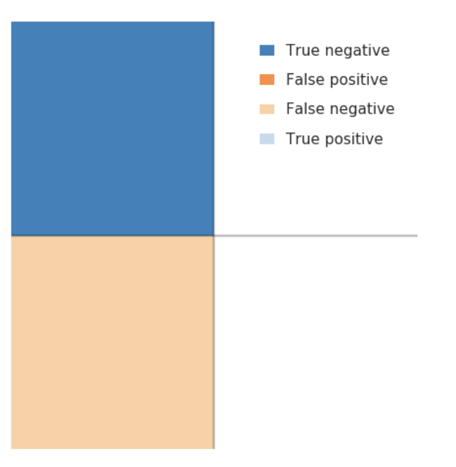
IRONHACK BOOTCAMP
Quick example - Confusion Matrix with Titanic data
Lets assert everyone died
Classic example of a NULL hypothesis
Accuracy = 0.61 (errors 0 39%)
Reducible error - add some variables / generalisations into our model to iterate towards better accuracy.
Irreducible error - survival based on chance - people jumped into the water to save relatives, jumped into lifeboats while they were being lowered, or jumped into the water.

Slide 61
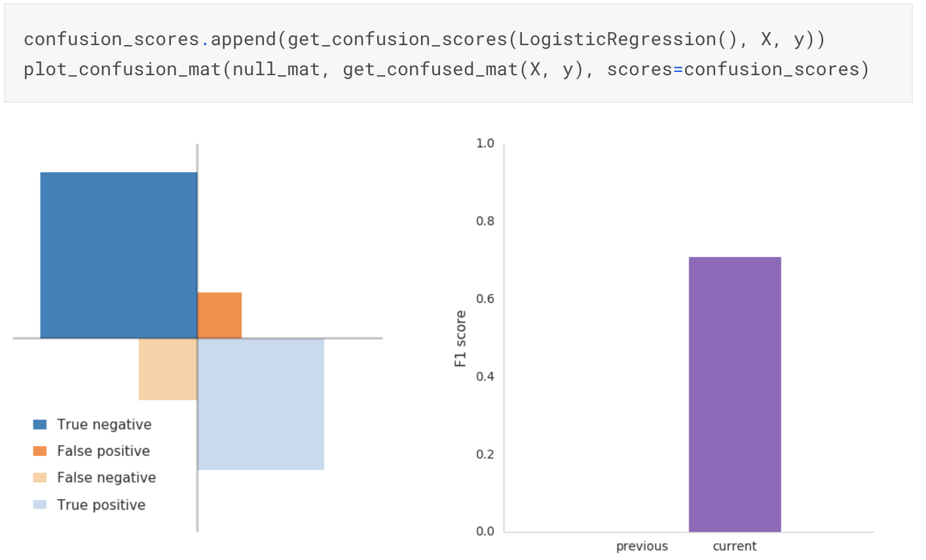
IRONHACK BOOTCAMP
Confusion Matrix with Titanic data- generalisation A
“women and children first” … lets assert all women survived
Notes:
Note from spiegalhalter book - high accuracy of this simple rule - though naive - is just behind some more complex algorithms. Demonstrates the inadequcy of crude accuracy as a measure of performance. Random forest - best discrimination under ROC curve, probabilities from simple classication tree have the best brier score - no clear winner . table write up whiteboard

Slide 62
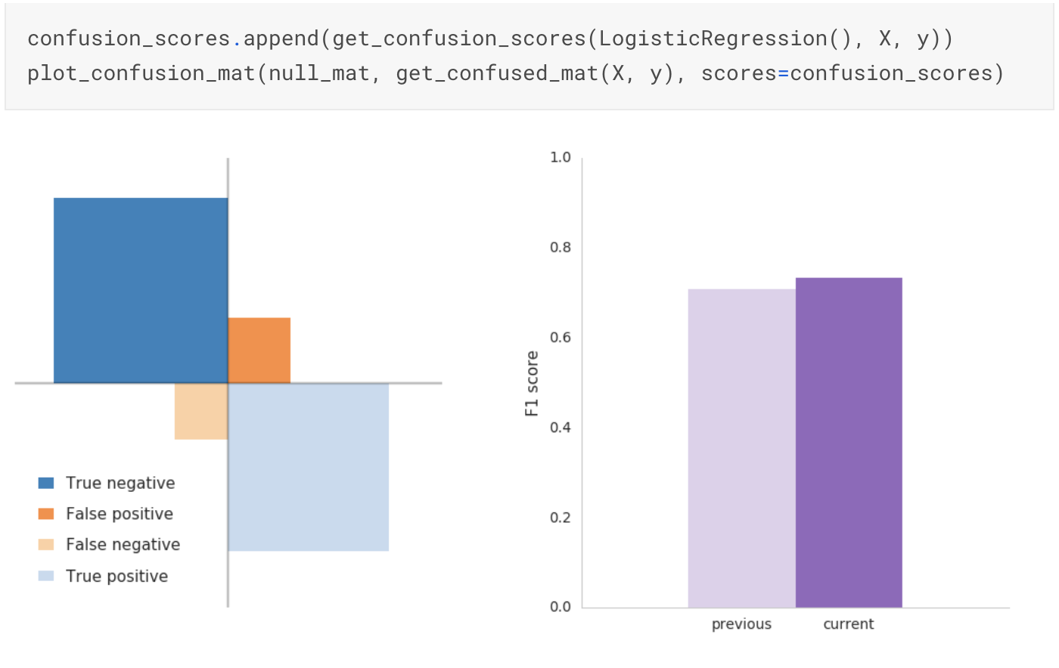
IRONHACK BOOTCAMP
Confusion Matrix with Titanic data- generalisation B
“women and children first” … split the children out
Notes:
Our score slightly improved but not as much as we may have anticipated. By accounting for children, we regained 23 male children misclassified as victims. These passengers were transferred from false negatives to true positives.
At the same time, our improvements were offset by an increase in false positives. Not all children survived. To account for this increase, we need to add dimension to our model

Slide 63
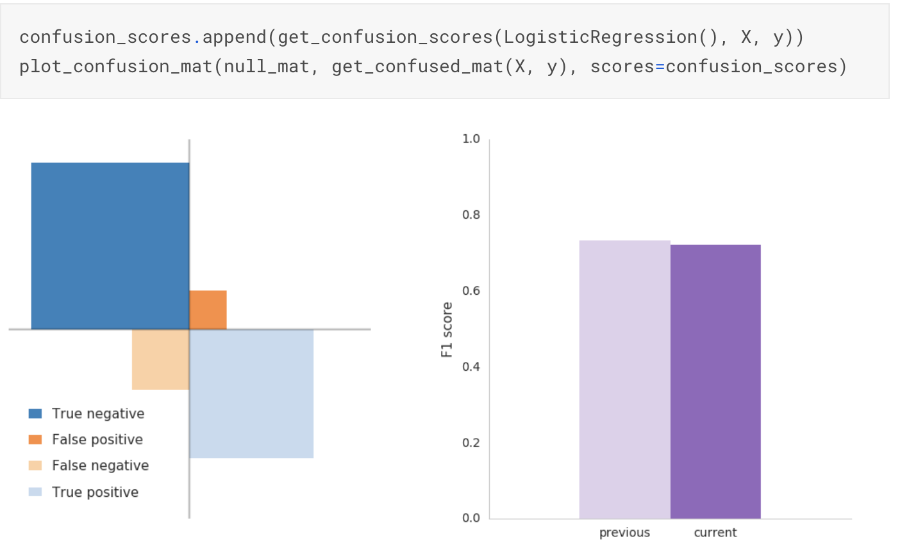
IRONHACK BOOTCAMP
Confusion Matrix with Titanic data- generalisation C
Class matters … split the passengers by class
Notes:
Our score improved again. Given the low survival rate in class 3, we increased our true negatives and reduced our false positives. We're now accounting for women and children who died in class 3. However, our false negatives are back up again. And our F1 decreased. Contrary to our model's assertion, not all class 3 passengers died.Can we find something in our data to account for surviving class 3 passengers?It's tricky.First, surviving class 3 passengers were very lucky. All other passengers had more time, more access and less people to compete with for a seat in the lifeboats. We can't generalize what's largely attributable to chance.Second, whatever feature we identify to account for surviving class 3 passengers needs to apply to class 1 and 2 passengers as well. If not, we'll trade false negatives between features.We need a featured shared by all passengers to more accurately account for passengers in class 3

Slide 64
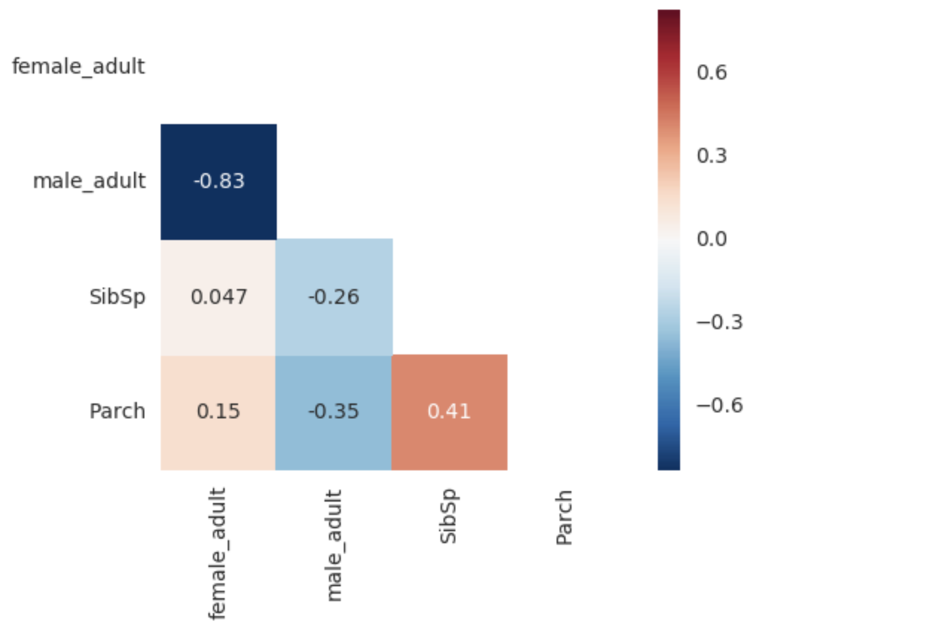
IRONHACK BOOTCAMP
Confusion Matrix with Titanic data- correlation matrix
No of siblings/spouses, parents/children is an influence on survival

Slide 65
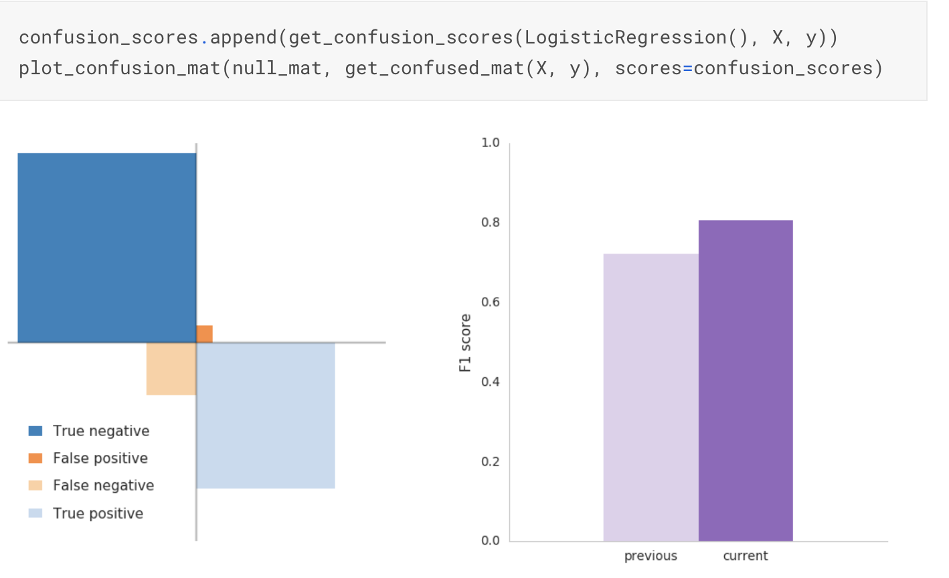
IRONHACK BOOTCAMP
Confusion matrix… perishing mothers/wives
No of siblings/spouses, parents/children is an influence on survival
Notes:
Had to create a feature called family based on surname etc , By accounting for perishing mothers/wives, we greatly improved our accuracy and reduced our false positives. It makes sense our model reduces false positives since we're making connections between people who likely died. The trade off between false positive and true negative is likely male children traveling in class 3 who we misclassified as survivors.

Slide 66

IRONHACK BOOTCAMP
Confusion matrix… surviving_father_husband
No of siblings/spouses, parents/children is an influence on survival
Notes:
By connecting male survivors (surviving_father_husband) with their families, we reduced our false negatives. The trade off between false negative and true positives is likely the male adults and male children in class 3 we misclassified as victims.

Slide 67
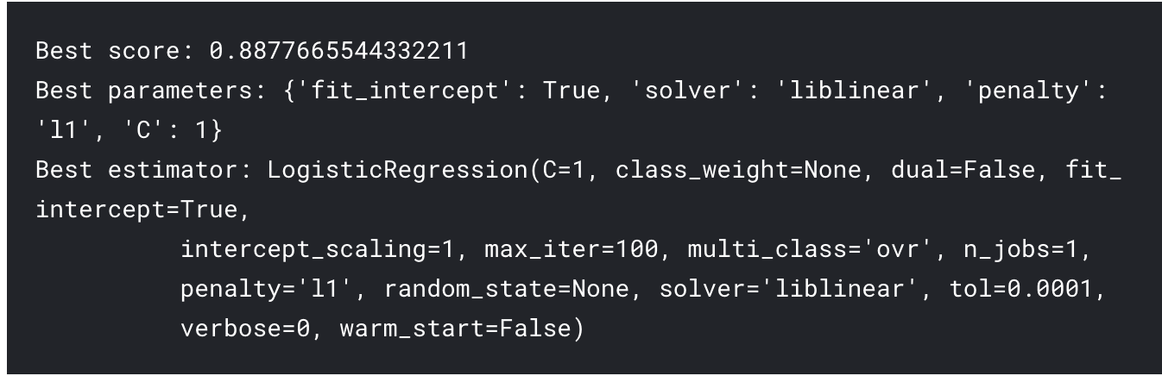
IRONHACK BOOTCAMP
Output Titanic data - final iteration

Slide 68
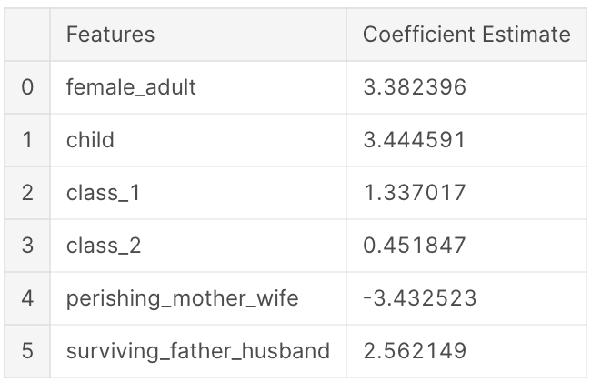
IRONHACK BOOTCAMP
Output Titanic data - overfitting?
We are definitely overfitting which is no surprise considering our strategy uses surnames from the training set to link family members.
But looking at our coefficients, we have a strong model.

Slide 69


